Slide 1
Quicksort!!!!! :D
By jack Nishanian

Slide 2
Why sorts are important
Sorting is a common task and has many implementations
There are certain things that sorted lists are faster at and vice versa
For example:
Adding data to an unsorted array is faster because you can put it at the end
Finding data in a sorted array is much faster then an unsorted array because you know, for example, that if you are looking for 50 and reach 55 you went too far
As a result sorting as fast a possible is important

Slide 3
What kind of sorts are there
Insertion sort
Bubble sort
Selection sort
Or the super awesome
AND RECURSIVE
*drum roll*
QUICKSORT!!!!!!!!!!!!!!!!!!!!!!!!!!!!!!!!!!!!!!!!!!!!!!!!!!!!!!!!!!!!!!!!!!!!!!!!!!!!!!!!!!!!!!!!!!!!!!!!!!!!!!!!!!!!!!!!!!!!!!!!!!!!!!!!!!!
DID HE JUST DO THAT?!?!

Slide 4
What a quicksort is
A quicksort is a recursive way to sort your arrays
Step 1: Choose an index
Step 2: Put everything less then that index to the left and everything greater than or equal to it to the right
Step 3: Consider everything to the left of the index and everything to the right as two new arrays to be sorted.
Step 4: Quicksort the left partition (which will keep calling Quicksort until the left is sorted)
Step 5: Quicksort the right partition (same as left)
Step 6: ??? Profit now that everything is sorted really fast.

Slide 5


See, doing Fibonacci sequence in recursion is bad (performance.) Sorting recursion is good.

Slide 6
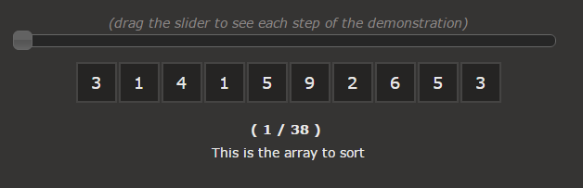
A Nice Interactive Example from the Web :D

Slide 7
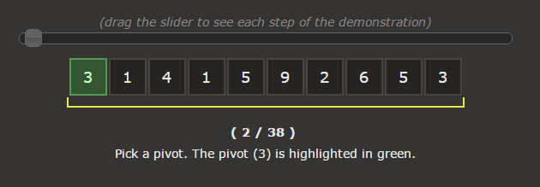
A Nice Interactive Example from the Web :D

Slide 8
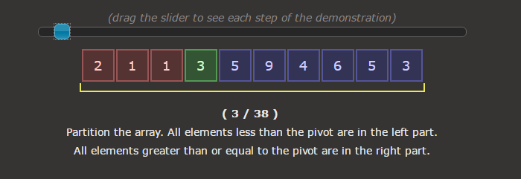
A Nice Interactive Example from the Web :D

Slide 9
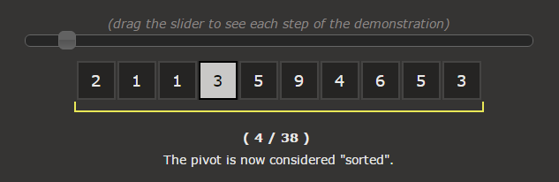
A Nice Interactive Example from the Web :D

Slide 10
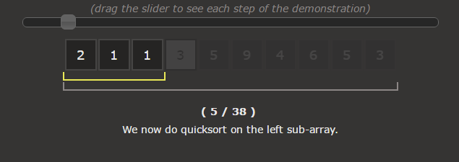

A Nice Interactive Example from the Web :D
RECURSION!!!!!!!!!!!!!!!!!!

Slide 11


Until eventually we are done…${We}^{Did^{it^{reddi{t!}^{shoutout^{to^{/r/learnprogramming}}}}}}$
The end… or is it!?

Slide 12
Works Used To Make This Presentation
http://me.dt.in.th/page/Quicksort/
https://www.toptal.com/developers/sorting-algorithms
https://www.youtube.com/watch?v=dQw4w9WgXcQ

